Slide 1
VIM and SVN
Yizhu
Notes:
Today, I will give you an introduction about vim and svn.
Both vim and svn are important tools for our usual experiment.
They can effectively improve our work efficiency.
Now, let’s have a look at the vim first.

Slide 2

VIM
Text Editor
Not based on menus but on commands
Text Manipulation
http://www.vim.org/
Notes:
Vim is one of the most frequently used text editor for Linux. It is also helpful on debugging.
Vim's interface is not based on menus or icons but on commands given in a text user interface.
Vim has powerful text manipulation capabilities. We can use vim to implement ‘delete’, ‘find’, ‘replace’ and many other operations.
This is the website about vim. And we can get some information about vim on it.

Slide 3
Mode
Normal Mode
Three Basic Modes
Insert Mode
Command Mode
Notes:
There are three basic modes in vim.

Slide 4
Mode
vi filemane
Normal Mode
we can’t type anything under normal mode
i
ESC
ESC
:
Insert Mode
Command Mode
q, qi, wq
Notes:
normal mode：input “vi filename” on the terminal we can access to normal mode. Note that we can’t type anything under normal mode Insert mode：Press i under the normal Mode it will get into Insert Mode. You can type program or text. When you press escap you will return to normal mode
Last line mode：press colon to access to the command mode. There will be a colon appeared in the lower left corner of the screen.
You can enter the command and execute it. Like Insert mode,you can press escap you to return to normal mode.
Besides, if you press q, qi or wq after colon, it will quit vim editor.

Slide 5
Installation
sudo apt-get install vim-gtk
Notes:
Next, I will introduce some vim operation by an example.

Slide 6
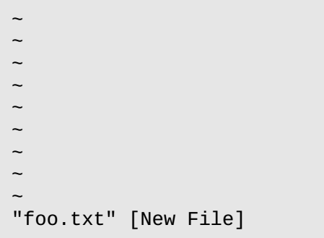


Example
Create a new file with vim: vi foo.txt
Press the “i” key
Save the work
Pressing the “:w”
Enter some text
Press ESC
Notes:
Create a new file with vim
we should get a screen like this: The leading tilde characters (”~”) indicate that no text exists on that line. This shows that we have an empty file. Now we can not type anything
Press the “i” key. we should see the following at the bottom of the screen press the Esc key, exit insert mode and return to command mode,
pressing the “:” key. Then a colon character should appear at the bottom of the screen To write our modified file, we follow the colon with a “w” then Enter: The file will be saved.
This is a simple text editing process.

Slide 7
Operation
l , h , j , k | Right Left Down Up
Ctrl-f | Down one page
Ctrl-b | Up one page
0 (zero) | To the beginning of the current line.
^ | To the first non-whitespace character on the current line.
$ | To the end of the current line
w | To the beginning of the next word or punctuation character
b | To the beginning of the previous word, ignoring punctuation characters.
H | To the beginning line of the screen
M | To the middle line of the screen
L | To the last line of the screen
G | To the last line of the file
gg | To the beginning line of the file
nG or ngg | To the line n
n<space> | Right n characters in this line
n<enter> | Down n lines
Normal Mode
The movement of the cursor
Notes:
Now , I will introduce some vim operation
The red part is frequently used operations.
When h, j, k, and l keys used for cursor movement , we can move the cursor without ever having to lift our fingers from the keyboard.
It will be fast. Many commands in vi can be prefixed with a number By prefixing a command with a number, we may specify the number of times
a command is to be carried out.

Slide 8
Operation
/word | Search the ‘word’ after cursor
?word | Search the ‘word’ before cursor
% | Specifies the range of lines for the operation. % is a shortcut meaning from the first line to the last line. Alternately, the range could have been specified 1,5 which means ‘from line 1 to line 5 in the file’. 1,$ means “from line 1 to the last line in the file.” If the range of lines is omitted, the operation is only performed on the current line.
s | Specifies the operation. In this case, substitution (search and replace).
/old/new/ | The search pattern and the replacement text
g | This means “global” in the sense that the search and replace is performed on every instance of the search string in the line. If omitted, only the first instance of the search string on each line is replaced.
Normal Mode
Search and replace
:%s/up/down/g
Notes:
We use / to move the cursor to the next occurrence of a word or phras.
When you type the / command a “/” will appear at the bottom of the screen.
Next, type the word or phrase to be searched for, followed by the Enter key.
The cursor will move to the next location containing the search string.
A search may be repeated using the previous search string with the n command.
Question: To change the word “up” to “down” for the entire file.

Slide 9
Operation
x, nx | Delete current character, delete current character and next (n-1) character
dd, ndd | Delete current line, delete current line and next (n-1) lines
d1G | Delete from the current cursor location to the beginning of the line
dG | Delete from the current line to the end
yy, nyy | Copy the current line, Copy the current line and the next (n-1) lines.
y1G | Copy from the current cursor location to the beginning of the line
yG | Copy from the current line to the end
p, P | Past in the next line of cursor, past in the last line of cursor
j | Combine the current line and next line
10cj | Delete 10 lines from the current cursor
u | Revok
Normal Mode
Delete, copy and past
Notes:
The d command not only deletes text, it also “cuts” text. Each time we use the
d command the deletion is copied into a paste buffer (think clipboard) that
we can later recall with the p command to paste the contents of the buffer
after the cursor or P command to paste the contents before the cursor
The y command is used to copy text in much the same way the d command is used to cut text.

Slide 10
Operation
i | Insert
a | Append text after the current cursor
o | Open a blank line below the current line
ESC | Access to normal mode
Insert Mode

Slide 11
Operation
:w | Save the current file
:q | Quit the current window
:q! | Quit the current window and throw away unsaved changes
:wq, ZZ | Save changes and quit the current window
:e! | Return to the initial state
:w[filename] | Save with a new name (but does not change the current name)
:r[filename] | Insert a file into the current document
:set nu | List the number of the lines
:command | show all functions/commands in vim (plugins, custom functions, etc.)
Command Mode
Tip: If you get “lost” in vim, try pressing the Esc key twice to find your way again.
Notes:
To exit, we enter the :q command The shell prompt should return. If, for some reason, vim will not quit (usually because we made a change to a file that has not yet been saved), we can tell vim that we really mean it by adding an exclamation point to the command: :q! But this time we throw away the unsaved changes.

Slide 12
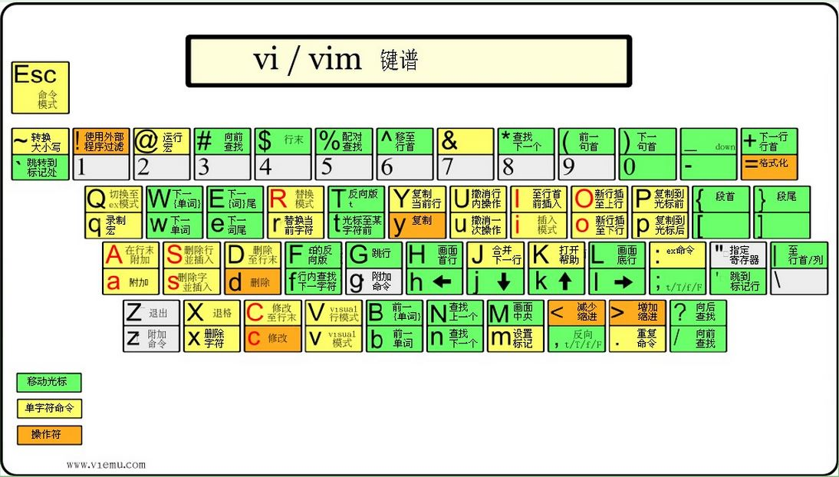
Help
Notes:
This is a picture about vim command on our keyboard. It can help us practice using vim.

Slide 13

SVN
Version control system
Operate across network
Notes:
Subversion is a free/open-source version control system.
SVN manages files and directories, and the changes made to them
This allows us to recover older versions of our data, or examine the history of how our data changed. SVN can operate across networks, which allows it to be used by people on different computers.

Slide 14
Concept
The Repository
Fundamental Concepts
Working Copies

Slide 15
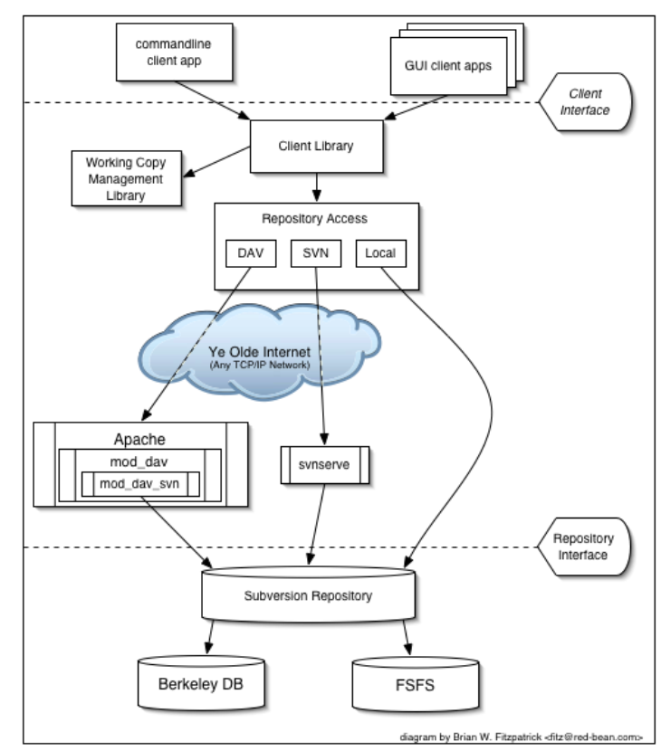
Notes:
One is a SVN repository that holds all of your versioned data.
The other is your SVN working copies, which manages local reflections of portions of that versioned data
Between these extremes are multiple routes through various Repository Access (RA) layers.
Some of these routes go across computer networks and through network servers which then access the repository.
Others bypass the network altogether and access the repository directly.

Slide 16
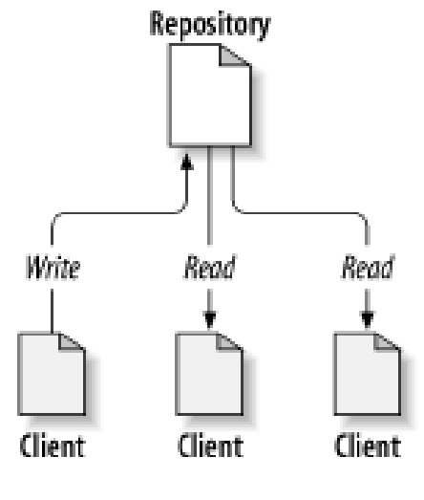
Repository
The repository is a central store of data.
a filesystem tree
Notes:
SVN is a centralized system for sharing information.
The repository is a central store of data.
The repository stores information in the form of a filesystem tree.
Any number of clients connect to the repository, and then read or write to these files.
By writing data, a client makes the information available to others; by reading data, the client receives information from others.
This is a “A typical client/server system”

Slide 17
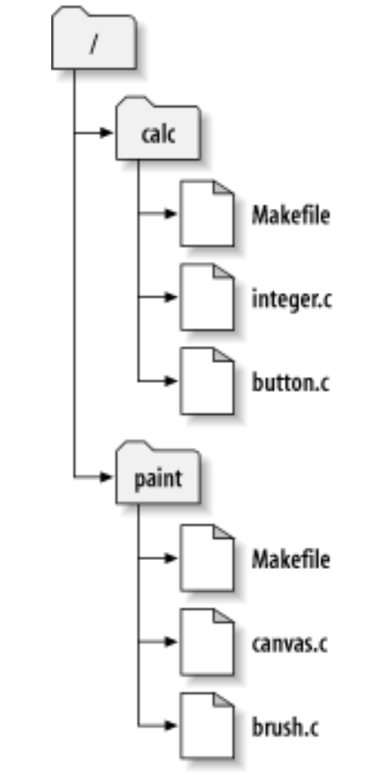
Working Copies
An ordinary directory tree
A private work area
Writing to/reading from the repository
Some extra files
subtree of the repository
Notes:
A SVN working copy is an ordinary directory tree on your local system, containing a collection of files.
Your working copy is your own private work area: SVN will never incorporate other people's changes, nor make your own changes available to others, until you tell it to do so.
After you've made some changes to the files in your working copy and verified that they work properly,
SVN provides you with commands to “publish” your changes to the other people working with you on your project (by writing to the repository).
If other people publish their own changes, SVN provides you with commands to merge those changes into yourworking directory (by reading from the repository). A working copy also contains some extra files, created and maintained by SVN
A typical Subversion repository often holds the files (or source code) for several projects;
usually, each project is a subdirectory in the repository's filesystem tree.
In this arrangement, a user's working copy will usually correspond to a particular subtree of the repository. This is the example

Slide 18
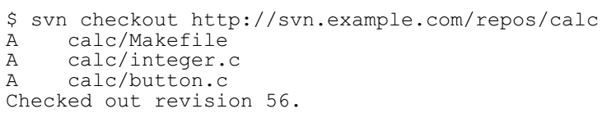
Operation
To get a working copy, you must check out some subtree of the repository.
checkout
-usage: svn checkout path
Notes:
The term “check out” may sound like it has something to do with locking or reserving resources, but it doesn't;
It simply creates a private copy of the project for you.

Slide 19
The typical work cycle
Working copy
exist
？
N
CheckOut
• Update your working copy • Make changes • Examine your changes • Possibly undo some changes • Resolve Conflicts
• Commit your changes
Y
Update
Make changes
Save
？
N
Revert
Undo some changes
Y
Examine your
changes
Commit
Other problem
N
Conflicts
？
N
successful
？
Y
Y
Resolve conflicts
Y
Continue
?
N
Notes:
This is the typical work cycle of the SVN

Slide 20
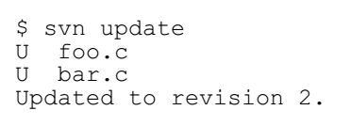
Update your working copy
update
-usage: svn update -r m path
In this case, someone else checked in modifications to both foo.c and bar.c since the last time you updated, and SVN has updated your working copy to include those changes.
Notes:
When working on a project with a team, we'll want to update our working copy to receive any changes made since your last update by other developers on the project. Use svn update to bring your working copy into sync with the latest revision in the repository.
svn update -r m path 例如： svn update如果后面没有目录，默认将当前目录以及子目录下的所有文件都更新到最新版本。 Need to change to the newest version svn update -r 200 test.php(将版本库中的文件test.php还原到版本200 简写：svn up

Slide 21
Make changes
add
-usage: svn add filename
svn add *.c
Add file to the repository.
delete
-usage: svn delete path -m filename
svn delete foo.c
svn ci -m foo.c
Delete file from the repository.
copy
-usage: svn copy filename bar
Create a new item bar as a duplicate of this file
and automatically schedule bar for addition.
move
-usage: svn move filename bar
The same as running svn copy foo bar; svn delete foo.
mkdir
-usage: mkdir PATH
Create the directory.
Notes:
svn add file svn add *.php(添加当前目录下所有的php文件)
svn delete path -m "delete test flie" another method to implement the function of svn
That is, bar is scheduled for addition as a copy of file, and the file is scheduled for removal.
Both svn copy and svn move does not create intermediate directories

Slide 22
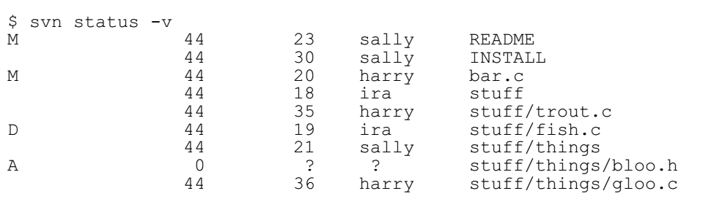
Examine your changes
status
-usage: svn status –v path
diff
-usage: svn diff path
svn diff -r m:n path
These two commands can be executed without network, because the SVN retain the original version copy in the local folder .svn.
Notes:
?：not in the control of svn
M：the content is changed
C：conflict
A：will be added to repository
K：locked
第一列保持相同，第二列显示，第三和第四列显示最后一次修改的版本号和修改人。
The changed document compared with basic version document
Compare version m and version n
svn diff path(将修改的文件与基础版本比较) 例如：svn diff test.php svn diff -r m:n path(对版本m和版本n比较差异) 例如：svn diff -r 200:201 test.php 简写：svn di

Slide 23
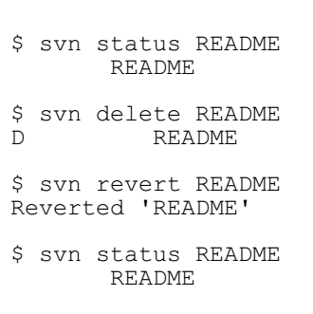
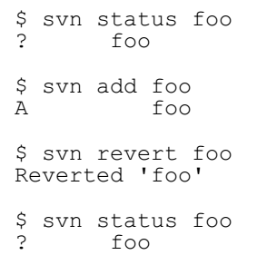
Possibly undo some changes
SVN reverts the file to its pre-modified state by overwriting it with the cached “pristine” copy from the .svn area.
revert
-usage: svn revert filename
It can be executed without network.
Notes:
Suppose while viewing the output of svn diff you determine that all the changes you made to a particular file are mistakes. Maybe you shouldn't have changed the file at all, or perhaps it would be easier to make different changes starting from scratch.
SVN reverts the file to its pre-modified state by overwriting it with the cached “pristine” copy from the .svn area.

Slide 24
Resolve Conflicts
update
-usage: svn update -r m path
If you get a conflict, you need to do one of three things: • Merge the conflicted text by examining and editing the conflict markers within the file. • Copy one of the temporary files on top of your working file. • Run svn revert <filename> to throw away all of your local changes.
resolved
-usage: svn resolved filename
Once you've resolved the conflict, you need to let SVN know by running svn resolved.
Notes:
svn resolved: 移除工作副本的目录或文件的“冲突”状态。 用法: resolved PATH...
This command doesn’t solve the conflict by grammar. It just remove the conflict related documents. Then , commit the file again.

Slide 25
Commit your changes
The svn commit command sends all of your changes to the repository.
commit
-usage: svn commit -m filename path
Commit failed (conflict):
update — make changes — resolved — commit
Notes:
svn commit -m "LogMessage" [-N] [--no-unlock] PATH(如果选择了保持锁，就使用--no-unlock开关) 例如：svn commit -m "add test file for my test" test.php 简写：svn ci
When you commit a change, you need to supply a log message, describing your change. Your log message will be attached to the new revision you create.
Now the typical work cycle is over.

Slide 26
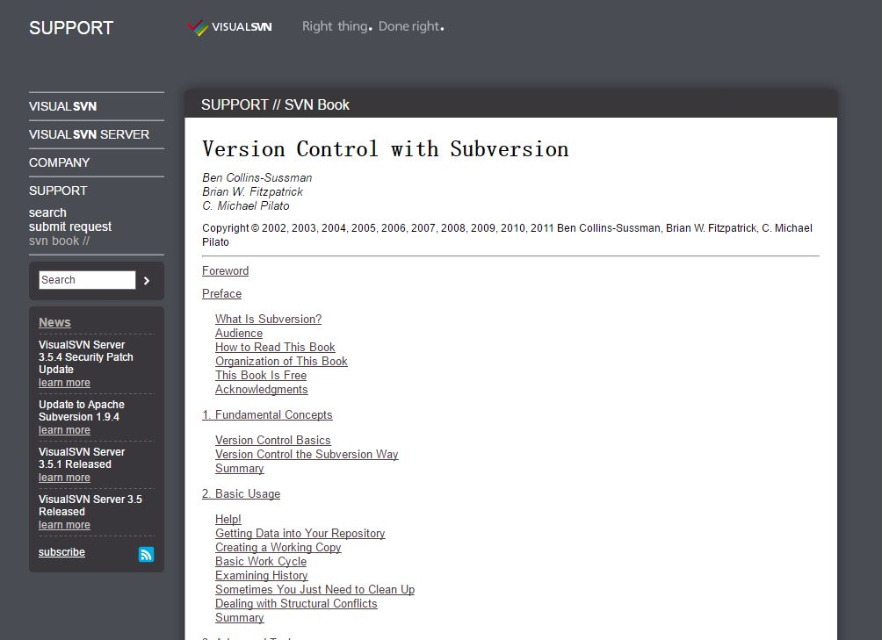
https://www.visualsvn.com/support/svnbook/
Notes:
Actually, there are still many svn operations I don’t mention.
If you want to know more , you can go to this website and get more information from it.

Slide 27
Practice more
Notes:
At last, a tip The more you practice it, the better you use it.

Slide 28
Thank you!

